Slide 1

Git for Version Control

Slide 2
Version Control
Management of changes to documents, computer programs, large web sites, and other collections of information.
Also known as “Source Control”
For collaborative project, one needs to see who changed what, when, why?
One also needs the whole version history

Slide 3
Version Control
How do you do your project?
Modifying existing code
Backing up working code
Checking if an idea works
If yes, then cool! If no, then revert back to the backed up code.

Slide 4
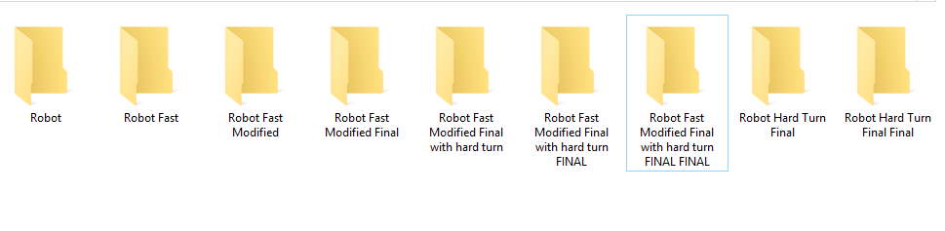
Version Control
What we generally do!
You thought this was bad?

Slide 5
Version Control
Open Source Projects
(Linux kernel has thousands of regular developers, millions of files.)
Big Code Base
(Win 95 had approx 5 million lines of code)
Hence comes Version Control System!

Slide 6

Git
Created by Linus Torvalds, creator of Linux Kerner, in 2005
It was designed to do version control for Linux kernel development

Slide 7
Git
Web link: https://git-scm.com/
Documentation: https://git-scm.com/doc
Pro Git book:
https://github.com/progit/progit2/releases/download/2.1.47/progit.pdf
Command Line help: (where verb = commit, add, push, pull etc.)
git help verb

Slide 8
Centralised Version Control
A single server holds the code base
Clients access the server by means of check-in/check-outs.
Examples include CVS, Subversion, Visual Source Safe.
When you're done, you "check in" back to the server.

Slide 9
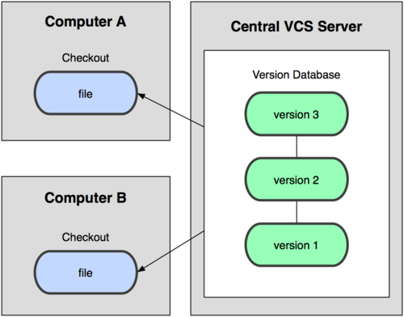
Centralised Version Control

Slide 10
Distributed Version Control
Each client (essentially) holds a complete copy of the code base.
Code is shared between clients by push/pulls
Many operations are local:
check in/out from local repo
commit changes to local repo
local repo keeps version history
When you're done, you can "push" changes back to server.

Slide 11
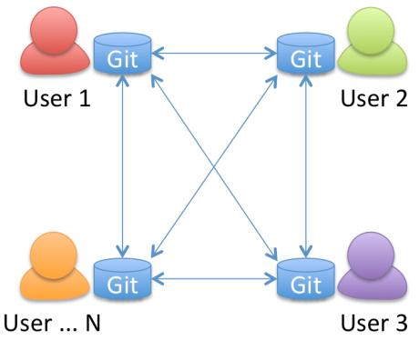
Distributed Version Control

Slide 12
File States
Committed
Modified, not staged, not committed
Staged (Staged files are ready to be committed)

Slide 13
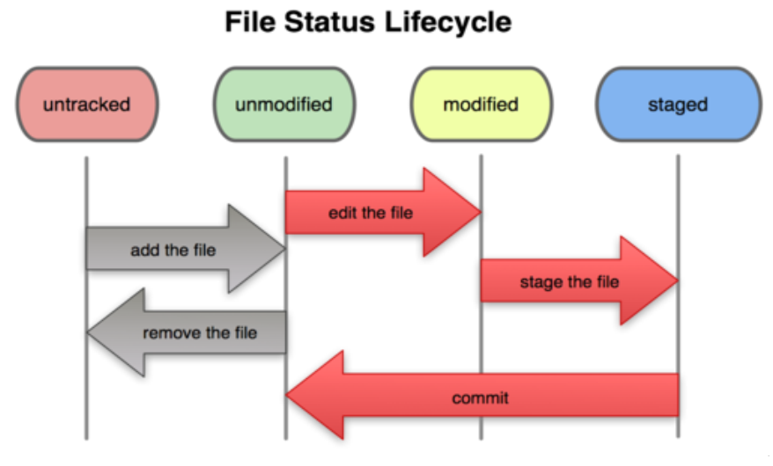
Workflow

Slide 14
Git
Let’s get our hands dirty!

Slide 15
Initial Configuration
Set the name and email for Git to use when you commit
git config --global user.name “matrix”
git config --global user.email mats@gmail.com

Slide 16
Creating a repo
git init (This will create a .git directory in your current directory)
git add hello.txt
git commit –m “first file”
You need to use both add and commit to save it to your repo. add only adds the file to the staging area. commit saves it permanently.

Slide 17
Commit
After commit you can see a message containing a sequence of seven hexadecimal characters. This is the starting of a 40 character hash value that is created by passing the contents of your file, the current timestamp, etc. to the SHA1 algorithm (a hashing algorithm).
Git has a special pointer named HEAD which simply points to the latest commit on the current branch

Slide 18
gitignore
There are certain files we would not generally want to keep track of.
For example, when we compile a latex file with pdflatex, it generates a log file, an aux file, and a pdf file.
We would not really want to maintain versions of these files, as we can easily generate these from the tex file.

Slide 19
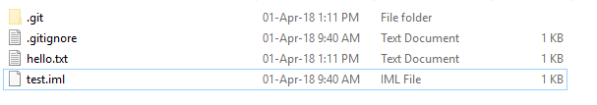
gitignore
To ignore these we will create a .gitignore file with the following line in it
*.log *.aux
Notice the use of wild card matcher \*", which would make git ignore any files ending with the stated extensions.

Slide 20
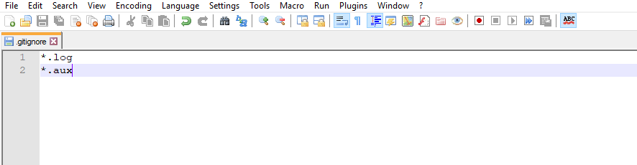
gitignore
For another example, when you create an intellij project, we don’t really want to version the .idea file or .iml files. Try to implement these.

Slide 21
Remote Repo
git pull origin master
(Fetches the most recent updates from the remote repo into your local repo, and puts them into your working directory)
git push origin master
(Puts your changes from your local repo in the remote repo)
git remote add origin LINK

Slide 22
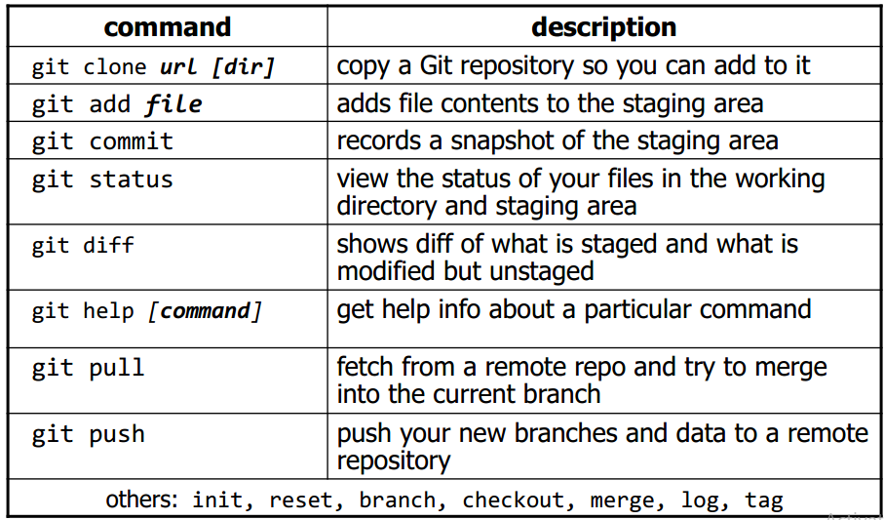
Git Commands

Slide 23
Status, undo, log
git status
git diff (will show which files are modified but unstaged)
git log (history)
git reset HEAD -- filename (Unstages the file)
git reset --hard SOME-COMMIT (Goes back to SOME-COMMIT)

Slide 24
Branching & Merging
git branch name (Creates a branch)
git branch (lists all branches)
git checkout branchname (switches to the local branch)
git checkout master
git merge branchname
(Merges changes from a branch to local master)

Slide 25
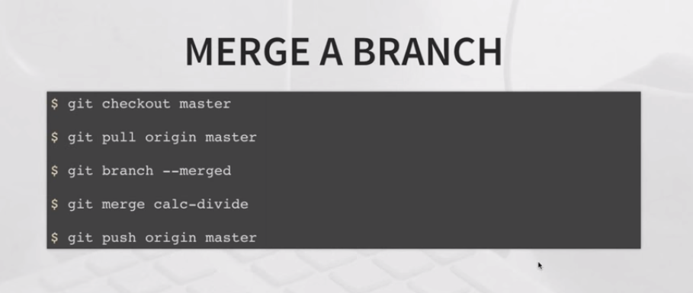
Branching & Merging

Slide 26
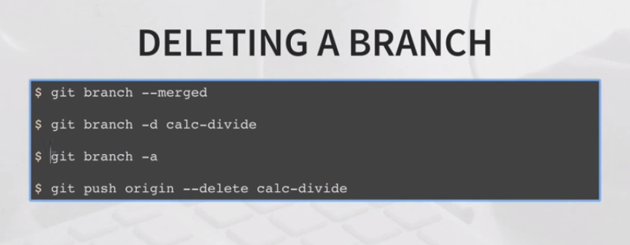
Branching & Merging

Slide 27
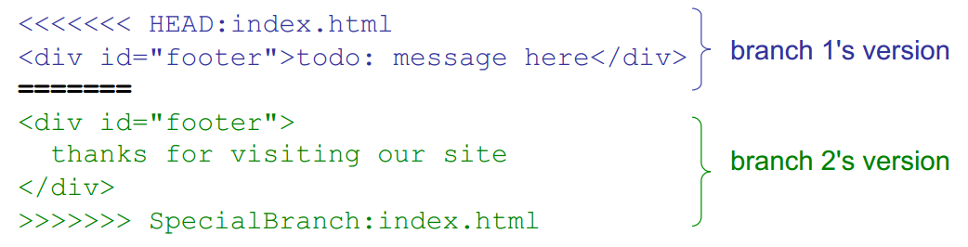
Merge Conflict
The conflicting file will contain <<< and >>> sections to indicate where Git was unable to resolve a conflict:
Find all such sections, and edit them to the proper state (whichever of the two versions is newer / better / more correct).

Slide 28
Github
GitHub.com is a site for online storage of Git repositories.
You can create a remote repo there and push code to it.
Many open source projects use it, such as the Linux kernel.
You can get free space for open source projects, or you can pay for private projects.

Slide 29
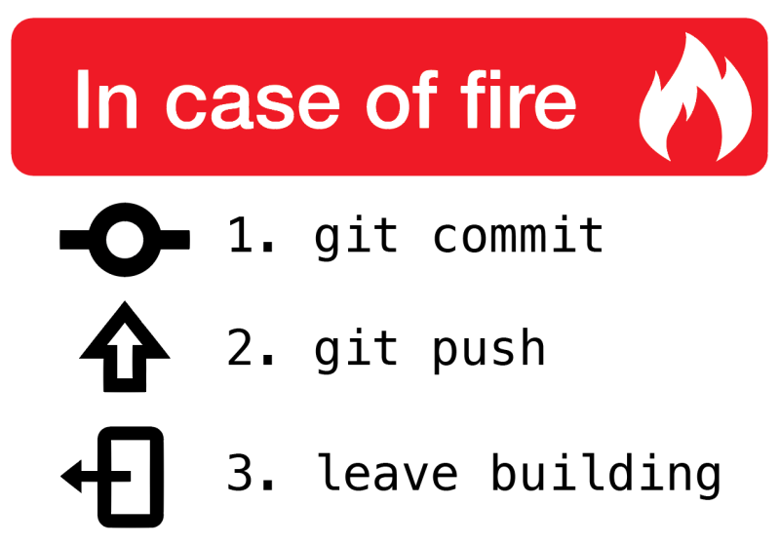
Git

Slide 30
Courtesy
https://git-scm.com/
https://en.wikipedia.org/wiki
https://courses.cs.washington.edu/courses/cse403/13au/lectures/git.ppt.pdf

Slide 31
THANK YOU!!!

Slide 32
